Slide 1
Configuring The User Profile Service
Notes:
This module discusses how to take advantage of the new Social Networking features in SharePoint Server 2010. You will learn how to set up the User Profile Service Application and to synchronize user profiles against Active Directory user accounts. The module discusses several other topics which rely on user profiles such as notes and tagging, audience targeting and MySites.

Slide 2
Agenda
User Profiles and Social Networking
Configuring the User Profile Service
Synchronizing User Profiles
Working with My Sites

Slide 3
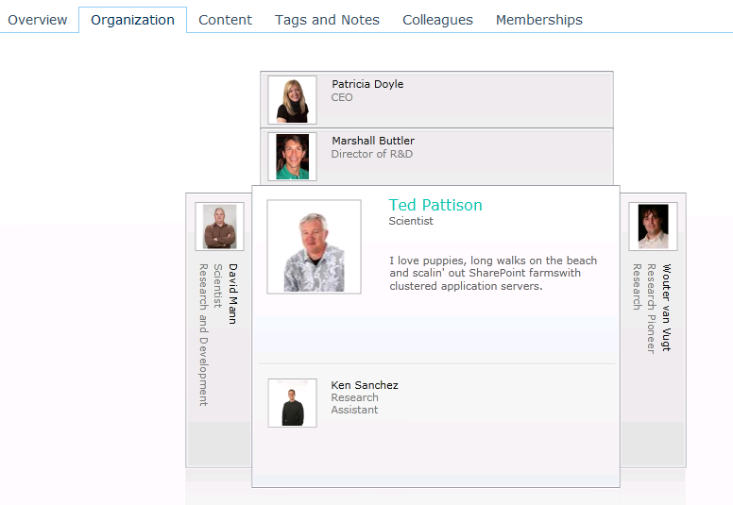
Social Computing Features
User Profiles
Rich Object Model
User Profile Web Service
Social Data
Tags, Comments, & Rating
Activity Feed
Social Data Service
Organization Browser
Notes:
People Data: The User Profile was good in 2003, got better in 2007 and in 2010 has still more advances.
The Activity Feed (I think) is the most significant new feature related to Social in SharePoint 2010. Consider the Activity Feed as a new alert channel.
A vehicle for notification of events from around your enterprise, not just SharePoint. Using Activity Templates you can craft your of communications channels for your users.
We’ll touch on Activities today and as they mature you will see much more content on how to use them.

Slide 4
Agenda
User Profiles and Social Networking
Configuring the User Profile Service
Synchronizing User Profiles
Working with My Sites

Slide 5
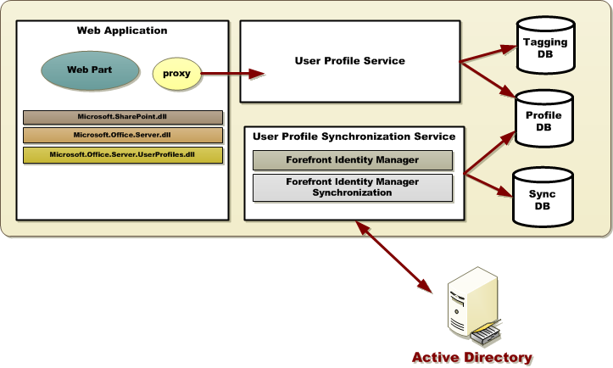
Architecture

Slide 6
Profile Store Architecture
User Profile DB
Profile and Activity Feed
Social Data DB
Tags, Keywords, Comments, Bookmark, Ratings
Mainly stores GUID (to the taxonomy term) or the note or rating, URI, Profile ID, Timestamp, URI disambiguation info
Term values for use on the Newsfeed and Tags & Notes Page
Sync DB
Staging sync data for AD, LDAP, BCS

Slide 7
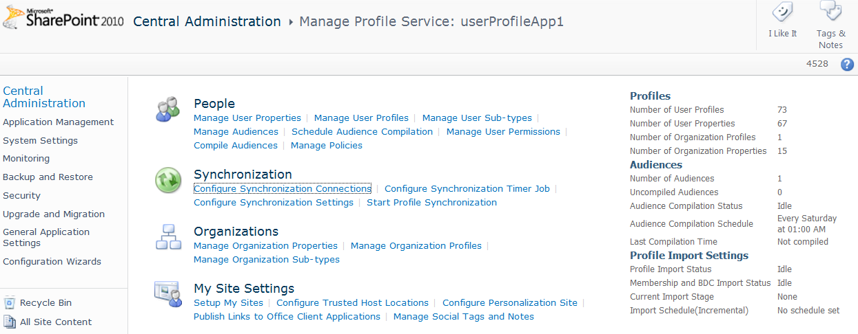
Key User Profile Service Considerations
Profile Customization
Profile Store architecture
Profile Synchronization
Scale
Performance
Federation and Replication

Slide 8
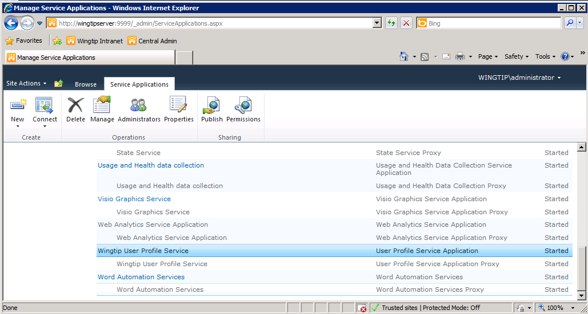
Service Application Management

Slide 9
Agenda
User Profiles and Social Networking
Configuring the User Profile Service
Synchronizing User Profiles
Working with My Sites

Slide 10
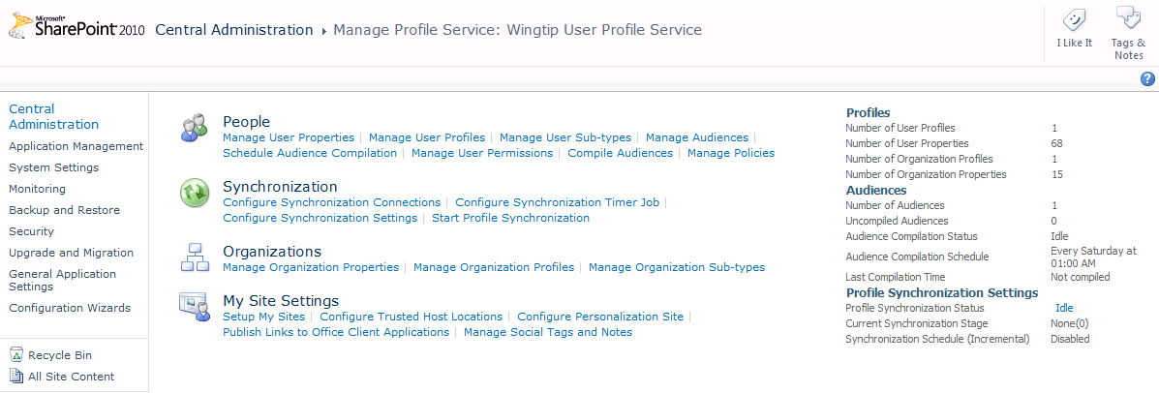
UPS Administration

Slide 11
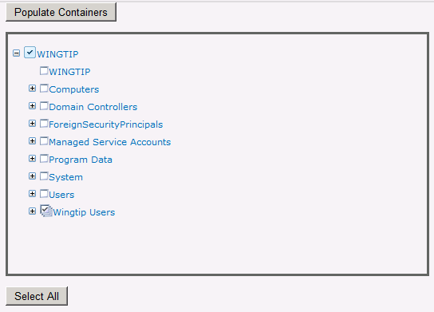
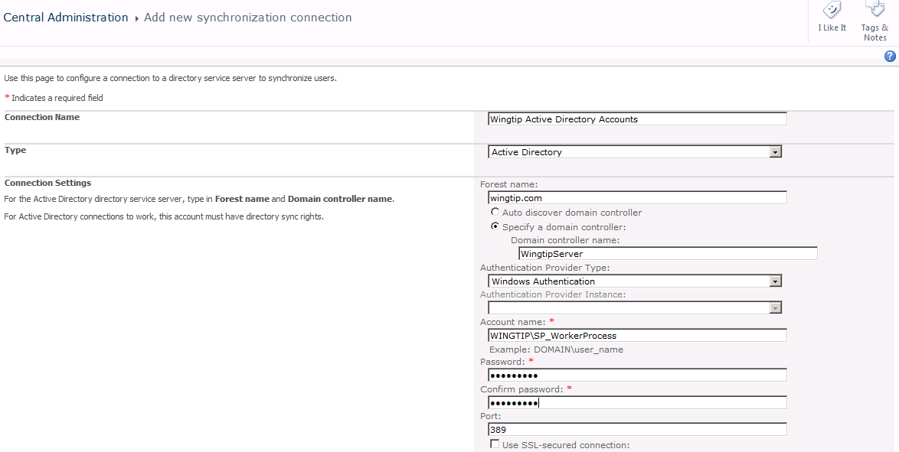
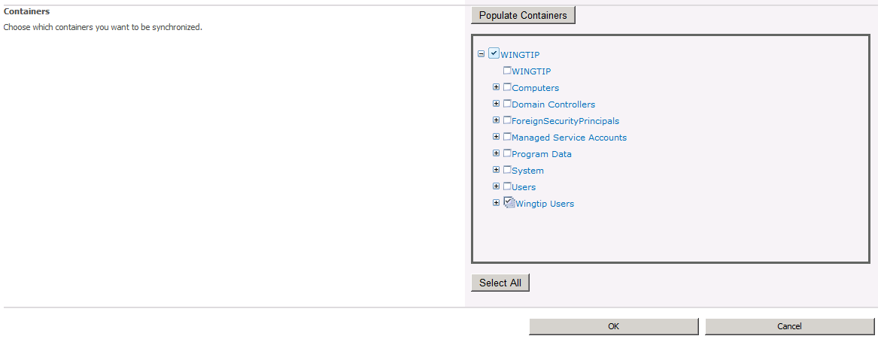
Configuring Sync Connections
Only select the appropriate OU
The Select All button is evil!

Slide 12
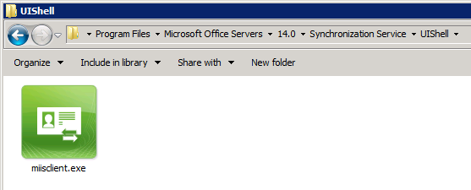
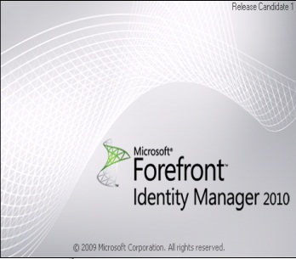
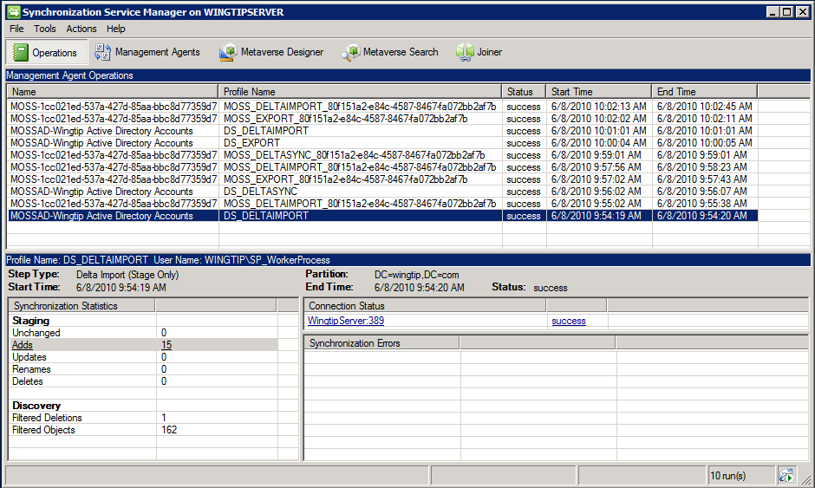
Forefront Identity Manager 2010
C:\Program Files\Microsoft Office Servers\14.0\Synchronization Service\UIShell\miisclient.exe

Slide 13
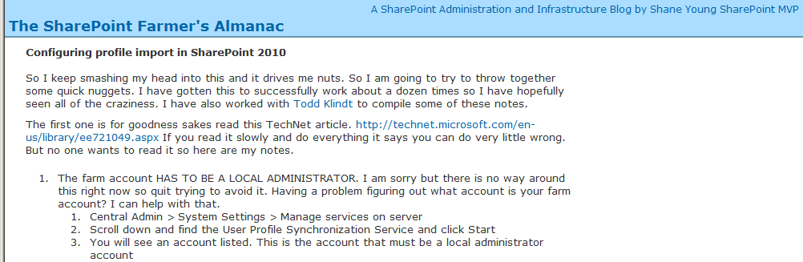
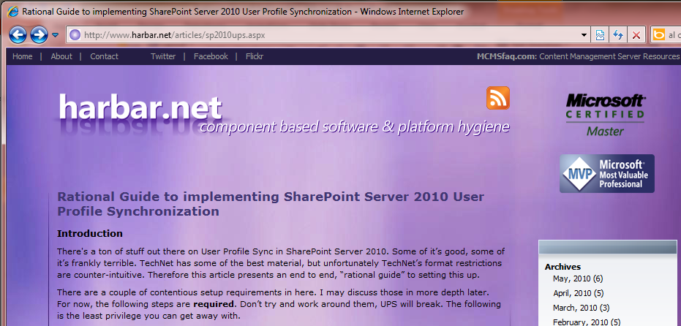
Getting Started Setting Up the UPS
http://msmvps.com/blogs/shane/archive/2010/07/09/ Configuring-profile-import-in-sharepoint-2010.aspx
http://www.harbar.net/articles/sp2010ups.aspx

Slide 14
Agenda
User Profiles and Social Networking
Configuring the User Profile Service
Synchronizing User Profiles
Working with My Sites

Slide 15
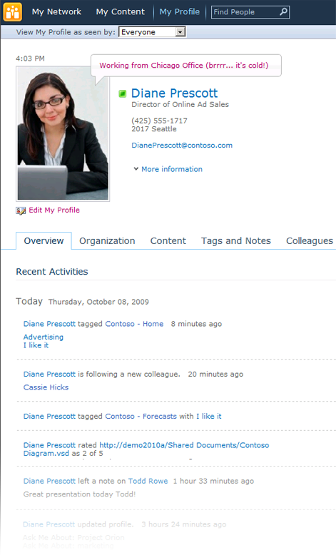
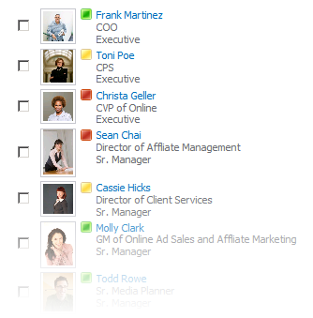
My Site
My Site personal portal
Social Feedback
People and Expertise Search
Notes:
My Sites also have a Note Board feature which works very much like the Facebook Wall where any one of your colleagues can write a message for you.
The My Network page in a My Site is a built in newsfeed. A running newsfeed of your colleagues’ activities (birthday, someone added a Tag, uploaded a document, etc.).
The My Profile page of the My Site also provides the user a microblogging platform sort of like Twitter.

Slide 16
My Site Components
My Network
My Profile
My Content
My <foo>
Pages
My Site
MySite Host
My Site
My Site
Site
Collections
My Web application
Web App
Managed Metadata
User Profiles
Search
Service
Application
Proxies
Notes:
My Sites are individualized sites created for each user profile that contain personal information about the user as well as personal and public views of information, documents, and other content. My Sites allow individuals to add colleagues and organize them into logical groupings. By using My Sites, users can keep track of their own activities as well as their colleagues.

Slide 17
Summary
User Profiles and Social Networking
Configuring the User Profile Service
Synchronizing User Profiles
Working with My Sites

